Slide 1
LinnOS : Predictability on Unpredictable Flash Storage with a Light Neural Network
Mingzhe Hao, Levent Toksoz, Nanqinqin Li, Edward Edberg Halim,
In 2020 USENIX Symposium on Operating Systems Design and Implementation
2021. 01. 26
Presentation by Han, Yejin
hyj0225@dankook.ac.kr
Notes:
Let me begin my presentation.
Today I will give a presentation on “Fully Automatic Stream Management for Multi-Streamed SSDs Using Program Contexts”

Slide 2
Introduction
Background
Motivation
LinnOS
Evaluation
Conclusion
Notes:
This is the outline on my talk.
First, I will describe garbage Collection overhead in SSDs and Multi-Streamed SSD
Then, the details of PCStream design and analysis results are presented.
Finally, I will conclude my talk.

Slide 3
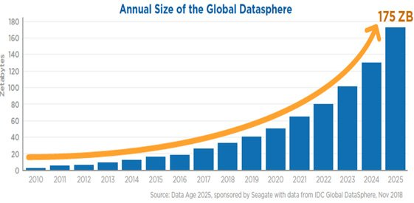

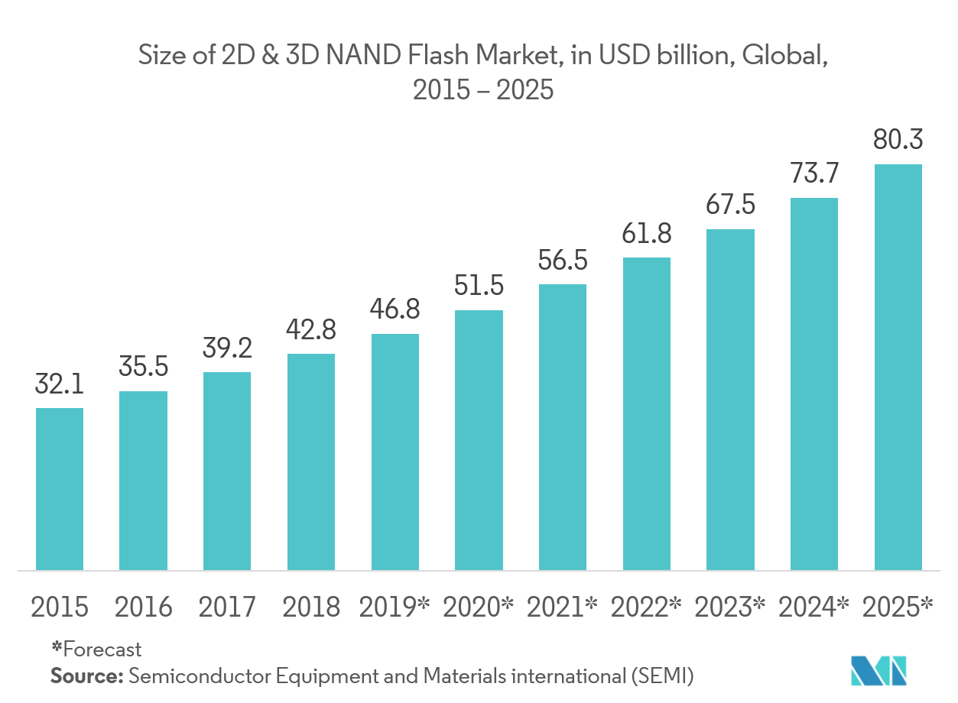


1. Introduction
175ZB by 2025
Faster and faster SSDs are available
SSD internal complexity grows
80 billion
Market by 2025
Unpredictable latency

Slide 4
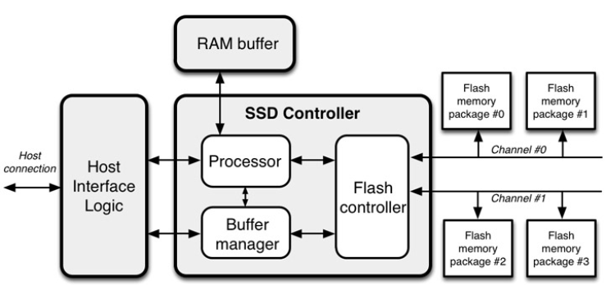
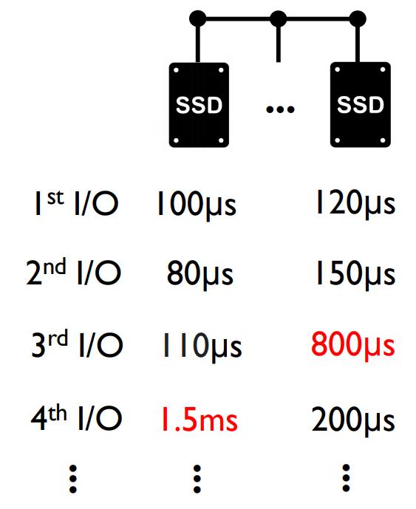
2. Background
Unpredictable latency
SSD internal complexities threats to performance stability
Buffer flushing
Unpredictable latency
at individual- I/O level
Garbage collection
Wear leveling
Notes:
NVM은 DRAM보다 용량이 크고 storage보다 속도가 빠르다. 영구적인 데이터를 접근할 때 메모리에 접근할 때처럼 byte단위로 접근이 가능하다 그래서 메모리와 스토리지 간의 페이지 블록 단위의 접근을 없앨 수 있다.

Slide 5




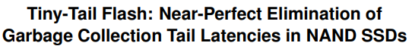
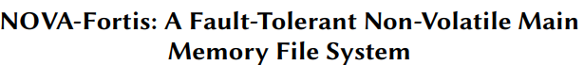


2. Background
Conventional Approaches for predictability
White/gray-box
Black-box
Re-architect device internals/interface
SSD-aware filesystems and applications
…
…
Powerful
Not modifying hardware
Need to modify hardware
Considerable re-design
in software stack
Notes:
DRAM과 PCM, NAND간의 속도차이가 몇배가 나는지 설명

Slide 6



2. Background
Conventional Approaches for predictability
Black-box: fs/storage applications, speculative execution
…
Hadoop
Notes:
DRAM과 PCM, NAND간의 속도차이가 몇배가 나는지 설명

Slide 7
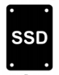

2. Background
Conventional Approaches for predictability
Black-box: fs/storage applications, speculative execution
…
Hadoop
Hedged requests
App
issue request
…
same replica
Notes:
DRAM과 PCM, NAND간의 속도차이가 몇배가 나는지 설명

Slide 8
2. Background
Conventional Approaches for predictability
Black-box: fs/storage applications, speculative execution
…
Hadoop
Hedged requests
slow
App
issue request
…
output
same replica
fast
delay
Mitigate every slow I/O!!
Notes:
DRAM과 PCM, NAND간의 속도차이가 몇배가 나는지 설명

Slide 9
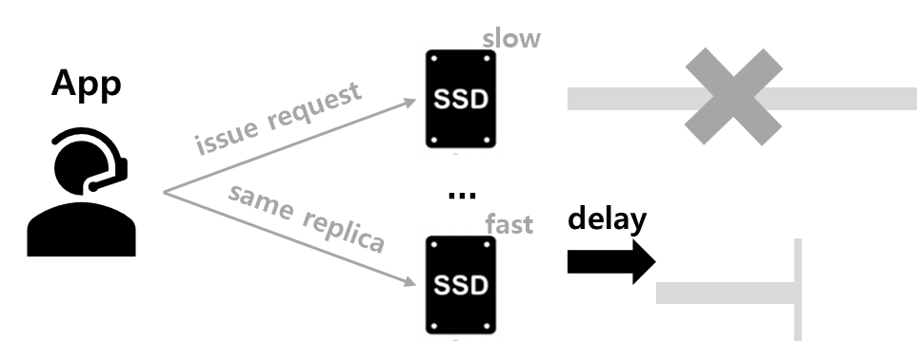

3. Motivation
Device-Agnostic
Learn the device behavior
speculative execution
- Passively wait due to black-box
LinnOS
- Proactively infer the black-box
- applications can know in advance
whether performance expectations
can be fulfilled
LinnOS
①
I/O attempt
App
②
Slow I/O →
Revoke I/O
…
③
I/O re-route
Light neural network
Fast & No-wait
Notes:
DRAM과 PCM, NAND간의 속도차이가 몇배가 나는지 설명

Slide 10
4. LinnOS
LinnOS
Machine learning for OS to learn black-box devices
Admission control for clustered storage applications
Per-I/O SSD performance prediction
Notes:
기존 OS는 NVM을 효과적으로 이용할 수 없다.

Slide 11
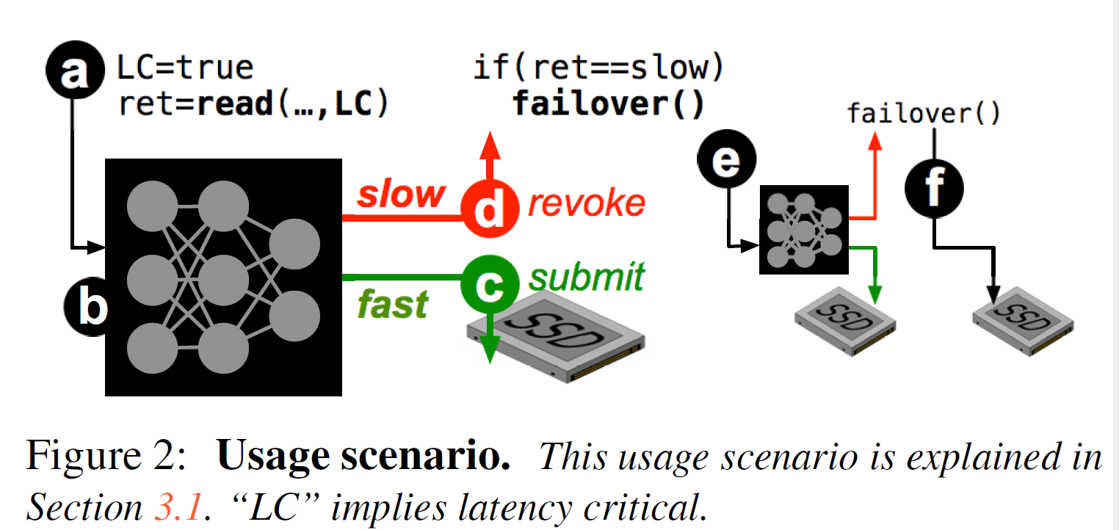
4. LinnOS
Usage scenario
Notes:
커널 개입을 여기서 써야하는가..?
동기: NVM을 잘 써야한다.

Slide 12
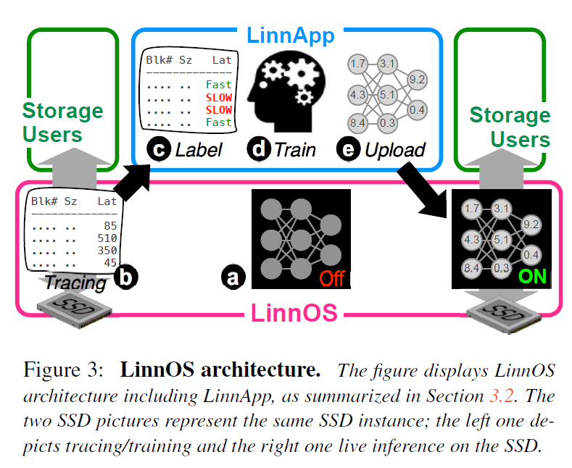
4. LinnOS
Overall architecture
Notes:
기존 OS는 NVM을 효과적으로 이용할 수 없다.

Slide 13

4. LinnOS
Design Challenges
Input
features
Output
labeling
Use what to predict?
(accuracy and inference overhead)
What to predict?
(accuracy and effectiveness)
Linn
OS
How to minimize the impact?
Handling
inaccuracy
Notes:
So, I will describe garbage Collection overhead in SSDs
As you all know, GC copies valid pages and reclaims free space. This results in write amplification, which has a significant impact on life and performance.
To reduce this overhead, a lot of research has been done in the past and there are examples A and B.

Slide 14
4. LinnOS
Design Solutions
Training Data Collection
Labeling (with Inflection Point)
Light Nerual Network Model
Improving Accuracy
Improving Inference Time

Slide 15
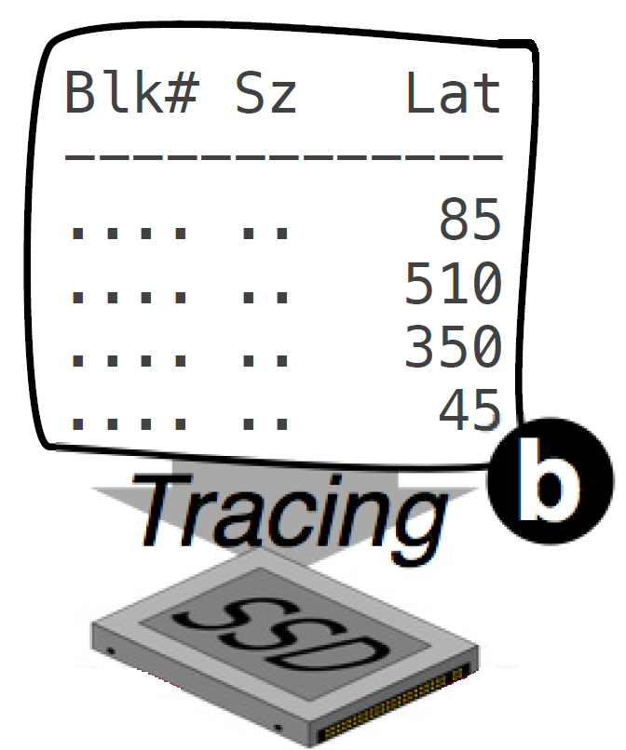
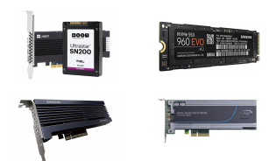

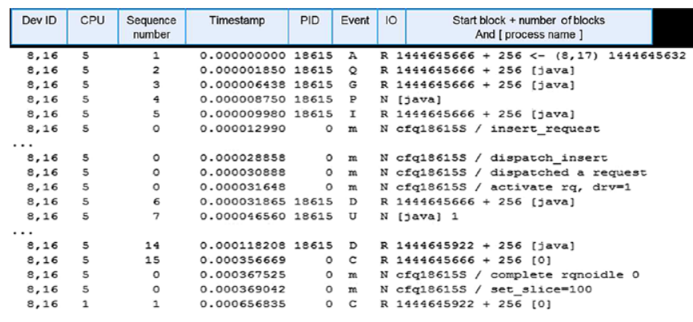
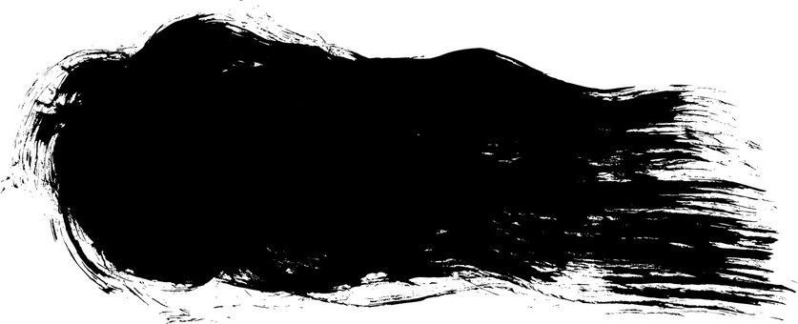






4. LinnOS
1) Training Data Collection
Online traces of real workload during busy-hour (e.g. midday)
Submission time, block offset/size, read/write, latency per I/O
A large “I/O data lake”
Blk# time off sz r/w Latency
blktrace
Tracing
cosmos
15
Notes:
Memory mapped I/O mmap I/O

Slide 16
4. LinnOS
Design Solutions
Training Data Collection
Output Labeling
Light Nerual Network Model
Improving Accuracy
Improving Inference Time

Slide 17

4. LinnOS
2) Output Labeling
Ideal Labeling
Only 60-70% accuracy
Exact μs-level latency
(e.g. 120μs, 70μs…)
Flexible
Only coarse-grained level
64-128μs
128-256μs
256-512μs
Mis-inferred
Linear labeling
(e.g. 0-10μs, 10-20μs…)
Truth
Too many labels
Hard to make accurate and fast
exponantial labeling
(e.g. 2-4μs, 4-8μs…)
Alternatives?
17
Notes:
Memory mapped I/O mmap I/O

Slide 18
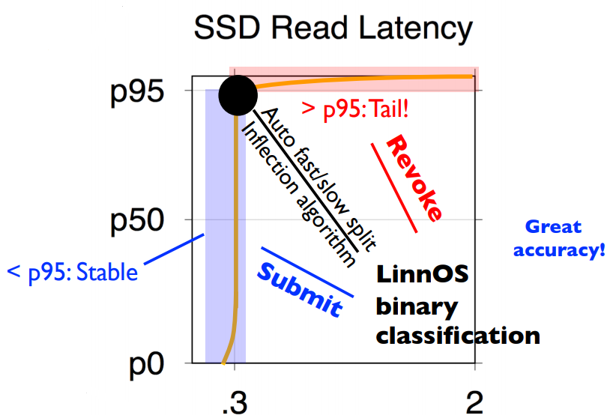
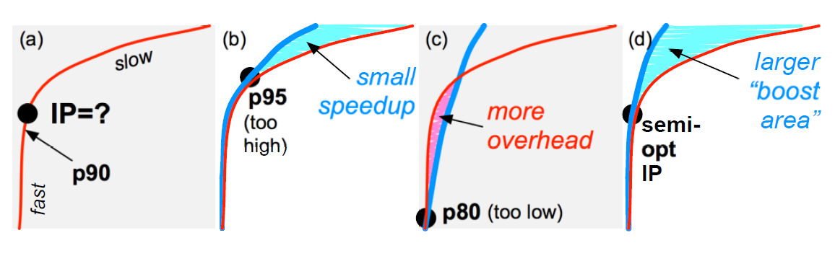
4. LinnOS
2) Output Labeling
Latencies often form a Pareto distribution with a high alpha number
Users only worry about the tail behavior, not the precise latency
Labeling with inflection point
Best inflection point
False submit
False revoke
How to find?
Latency (ms)
18
Notes:
Memory mapped I/O mmap I/O

Slide 19
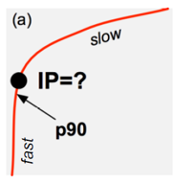
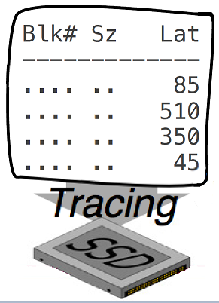
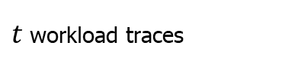
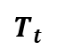
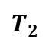
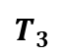
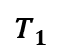
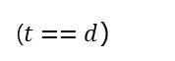
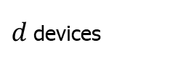
4. LinnOS
2) Output Labeling
Inflection Point Algorithm
Latency distribution
…
$$T_{1}$$
$$T_{2}$$
$$T_{3}$$
$$T_{t}$$
$t$workload traces
…
($t==d$)
$d$devices
19
Notes:
Memory mapped I/O mmap I/O

Slide 20
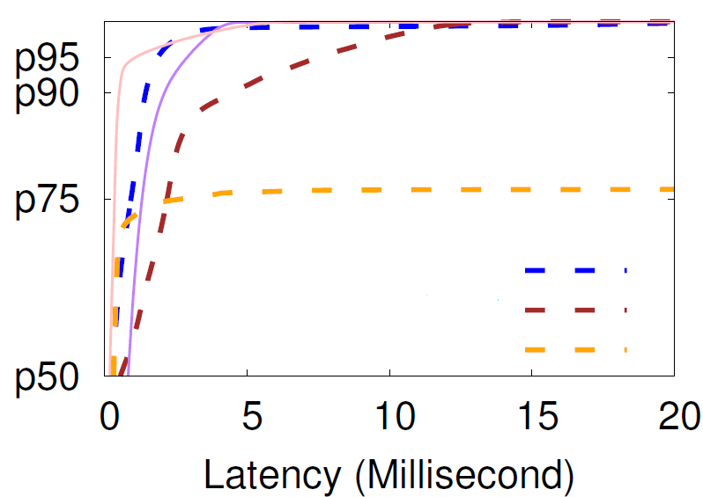

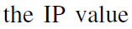




4. LinnOS
2) Output Labeling
Inflection Point Algorithm
Latency distribution
…
$$T_{1}$$
$$T_{2}$$
$$T_{3}$$
$$T_{t}$$
$t$workload traces
…
($t==d$)
$d$devices
1) Pick a starting IP value
$$T_{1}$$
$$T_{2}$$
$$T_{3}$$
1
20
Notes:
Memory mapped I/O mmap I/O

Slide 21
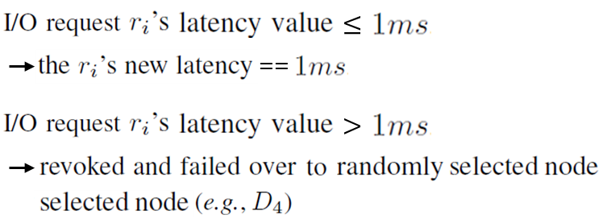
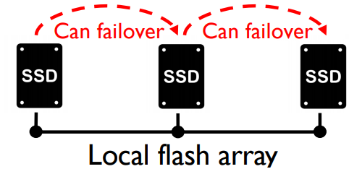
4. LinnOS
2) Output Labeling
Inflection Point Algorithm
Latency distribution
…
$$T_{1}$$
$$T_{2}$$
$$T_{3}$$
$$T_{t}$$
$t$workload traces
…
($t==d$)
$d$devices
1) Pick a starting IP value
2) Simulate/repeat admission control
$$T_{1}$$
$$T_{2}$$
$$T_{3}$$
1
21
Notes:
Memory mapped I/O mmap I/O

Slide 22
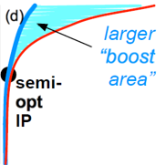

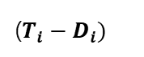
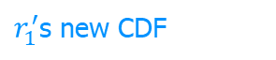
4. LinnOS
2) Output Labeling
Inflection Point Algorithm
Latency distribution
…
$$T_{1}$$
$$T_{2}$$
$$T_{3}$$
$$T_{t}$$
$t$workload traces
…
($t==d$)
$d$devices
1) Pick a starting IP value
2) Simulate/repeat admission control
3) New CDFs and pick the ${IP}^{max}$
$r_{1}^{′}$s new CDF
…
$$T_{1}$$
($T_{i}−D_{i})$
$$T_{2}$$
$$T_{3}$$
1
22
Notes:
Memory mapped I/O mmap I/O

Slide 23
4. LinnOS
Design Solutions
Training Data Collection
Labeling (with Inflection Point)
Input features
Improving Accuracy
Improving Inference Time

Slide 24
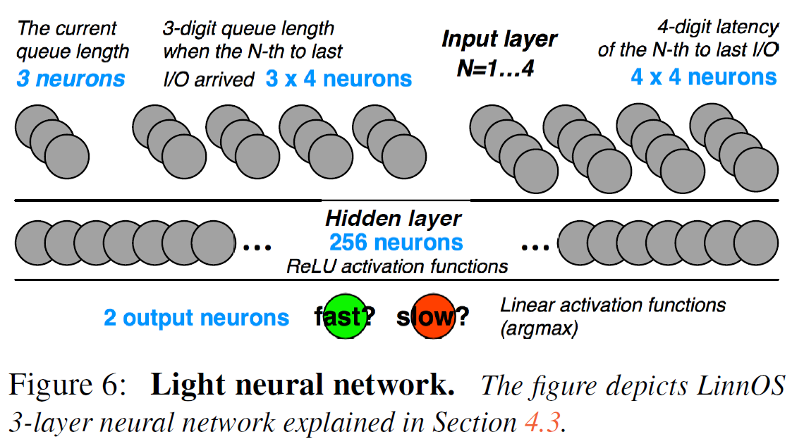
4. LinnOS
3) Input features
The number of pending I/Os (4KB pages) when an incoming I/O arrives
The latency of the 4 most-recently completed I/Os
The number of pending I/Os when each of the 4 completed I/Os arrived
24
Notes:
Memory mapped I/O mmap I/O

Slide 25
4. LinnOS
3) Input features
The number of pending I/Os (4KB pages) when an incoming I/O arrives
The latency of the 4 most-recently completed I/Os
The number of pending I/Os when each of the 4 completed I/Os arrived
Good latency indicator
Low history queue length
+ high history latency
= internal disruption
25
Notes:
Memory mapped I/O mmap I/O

Slide 26
4. LinnOS
3) Input features
The number of pending I/Os (4KB pages) when an incoming I/O arrives
The latency of the 4 most-recently completed I/Os
The number of pending I/Os when each of the 4 completed I/Os arrived
input format?
26
Notes:
Memory mapped I/O mmap I/O

Slide 27
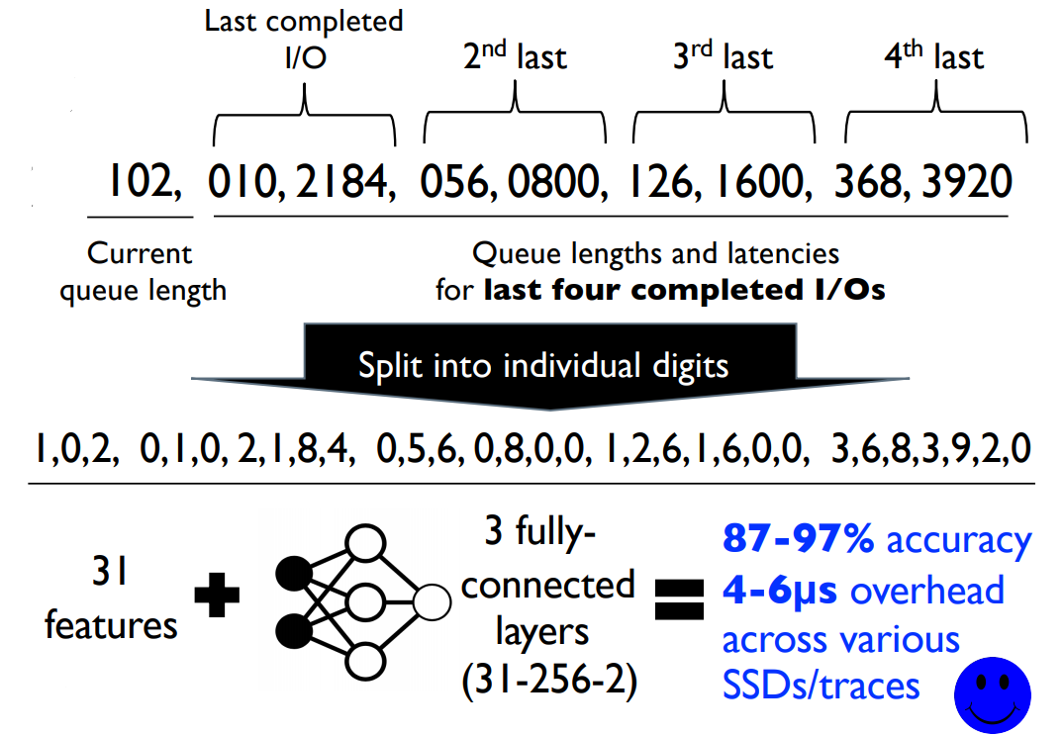
4. LinnOS
3) Input features
Format the number of pending I/Os into three decimal digits
Format μs latency value into four digits
LinnOS model takes 31 input features, each a one-digit decimal number
Split into individual digits
27
Notes:
Memory mapped I/O mmap I/O

Slide 28
4. LinnOS
3) Input features
Format the number of pending I/Os into three decimal digits
Format μs latency value into four digits
LinnOS model takes 31 input features, each a one-digit decimal number
Split into individual digits
28
Notes:
Memory mapped I/O mmap I/O

Slide 29
4. LinnOS
Design Solutions
Training Data Collection
Labeling (with Inflection Point)
Light Nerual Network Model
Improving Accuracy
Improving Inference Time

Slide 30
4. LinnOS
4) Improving Accuracy
Wrong inference penalty is small for false revokes but high for false submits
Use customized loss function: biased training
Reduce false submits by allowing more false revokes
false
submits
==
Mistakenly
Accept a slow I/O
==
Costs up to
milliseconds!
More penalty weight
Inaccurate
inference
Biased
training
Less penalty weight
false
revokes
==
Mistakenly
Revoke a fast I/O
==
Costs μs-level
Failover
30
Notes:
Memory mapped I/O mmap I/O

Slide 31
4. LinnOS
Design Solutions
Training Data Collection
Labeling (with Inflection Point)
Light Nerual Network Model
Improving Accuracy
Improving Inference Time

Slide 32
4. LinnOS
5) Improving Inference Time
Quantization
Storage functionalities are striping and partitioning using mod operations over integers
Floting point calculations are expensive and hard to manage inside the OS
Adopt DNN quantization by maintaining precision of three decimal points
Co-processors
Can Utilize one additional CPU core (if available)
reduce the inference time from 6 to 4μs with 2-threaded optimized matrix multiplication
32
Notes:
Memory mapped I/O mmap I/O

Slide 33

4. LinnOS
Summary
Input
features
Output
labeling
Current queue length
Queue lengths and latencies of history I/Os
Binary classification (fast/slow)
Inflection point Algorithm
Linn
OS
Handling
inaccuracy
Biased training
Different Penalty weights
for false submit/revoke
Notes:
So, I will describe garbage Collection overhead in SSDs
As you all know, GC copies valid pages and reclaims free space. This results in write amplification, which has a significant impact on life and performance.
To reduce this overhead, a lot of research has been done in the past and there are examples A and B.

Slide 34
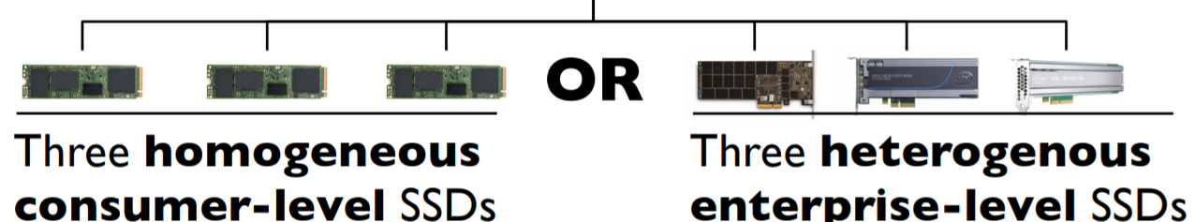

5. Evaluation
Setup
1) workload 2) devices 3) The experiments
real production SSD-level traces
Microsoft Azure server
Bing Index server
Bing Select server
Cosmos server
3 Samsung SM951 M.2 NVMe
Methods compared:
Baseline
Cloning
Hedging at p95
Hedging at IP
Simple heuristic
Advanced heuristic
LinnOS without hedging
LinnOS
Intel P4600
Samsung PM1725a NVMe
WD ultrastar DC SN200 NVMe
enterprise-level SSDs
App
r/w workloads
I8 CPU core (36-thread)
128GB DRAM
+ 6 SSDs for accuracy evaluation
SM951
SM951
SM951

Slide 35
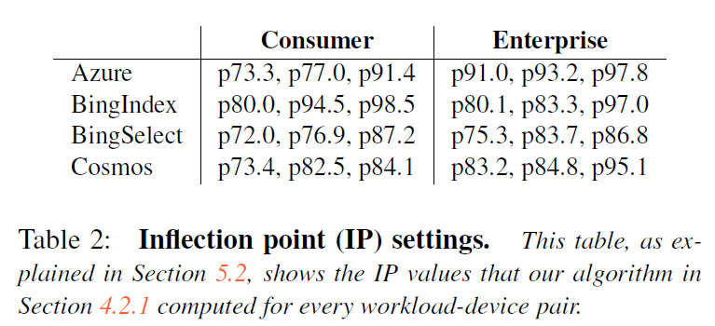
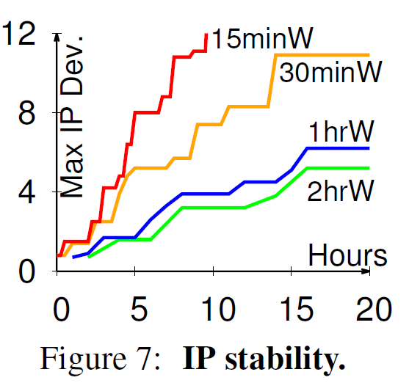
5. Evaluation
Inflection Point (IP) Stability
Notes:
So, I will describe garbage Collection overhead in SSDs
As you all know, GC copies valid pages and reclaims free space. This results in write amplification, which has a significant impact on life and performance.
To reduce this overhead, a lot of research has been done in the past and there are examples A and B.

Slide 36
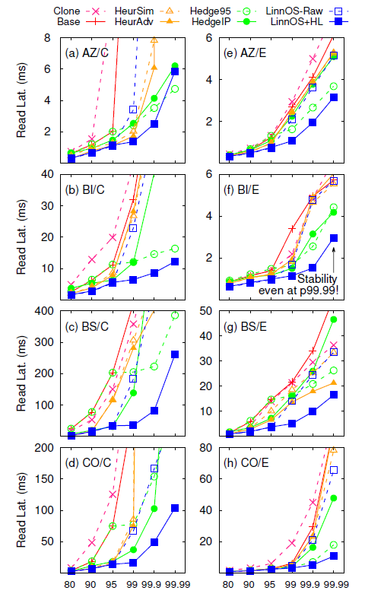
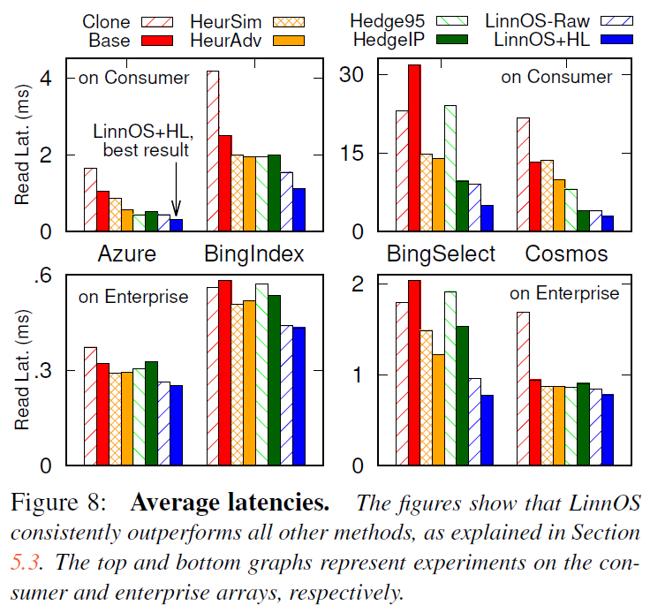
5. Evaluation
reduces average latency by 9.6-79.6%
Brings stable latencies
Notes:
So, I will describe garbage Collection overhead in SSDs
As you all know, GC copies valid pages and reclaims free space. This results in write amplification, which has a significant impact on life and performance.
To reduce this overhead, a lot of research has been done in the past and there are examples A and B.

Slide 37
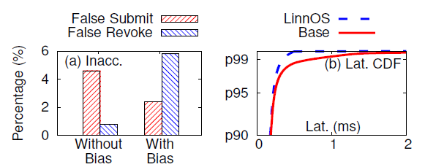
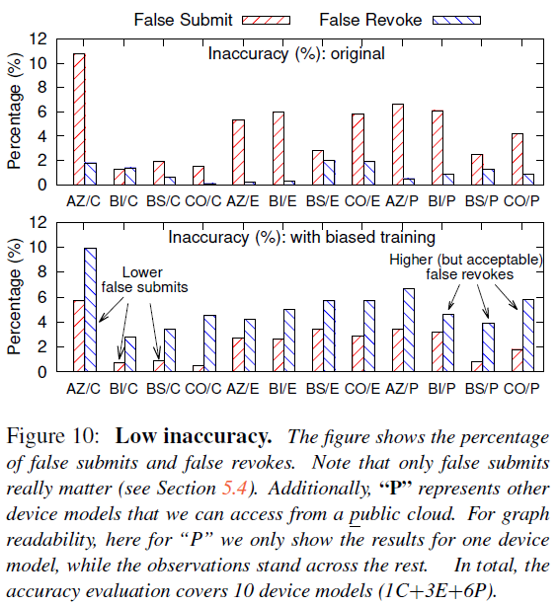
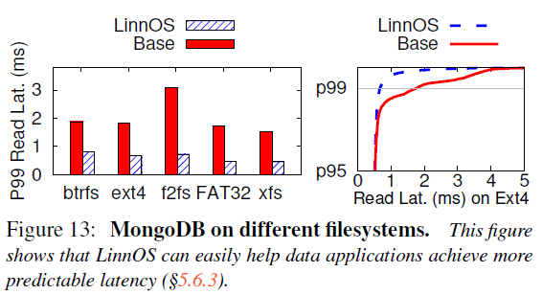
5. Evaluation
high accuracy with low false submit/revoke
Works on public traces
Helps MongoDB and FS
Notes:
So, I will describe garbage Collection overhead in SSDs
As you all know, GC copies valid pages and reclaims free space. This results in write amplification, which has a significant impact on life and performance.
To reduce this overhead, a lot of research has been done in the past and there are examples A and B.

Slide 38
6. Conclusion
LinnOS
Demonstrate that it is possible to incorporate machine learning into OS
Outperforms many other popular methods
Successfully predict the speed of every I/O to flash storage

Slide 39
LinnOS : Predictability on Unpredictable Flash Storage with a Light Neural Network
Mingzhe Hao, Levent Toksoz, Nanqinqin Li, Edward Edberg Halim,
In 2020 USENIX Symposium on Operating Systems Design and Implementation
Thank You!
2021. 01. 26
Presentation by Han, Yejin
hyj0225@dankook.ac.kr
Notes:
Let me begin my presentation.
Today I will give a presentation on “Fully Automatic Stream Management for Multi-Streamed SSDs Using Program Contexts”

